Slide 1
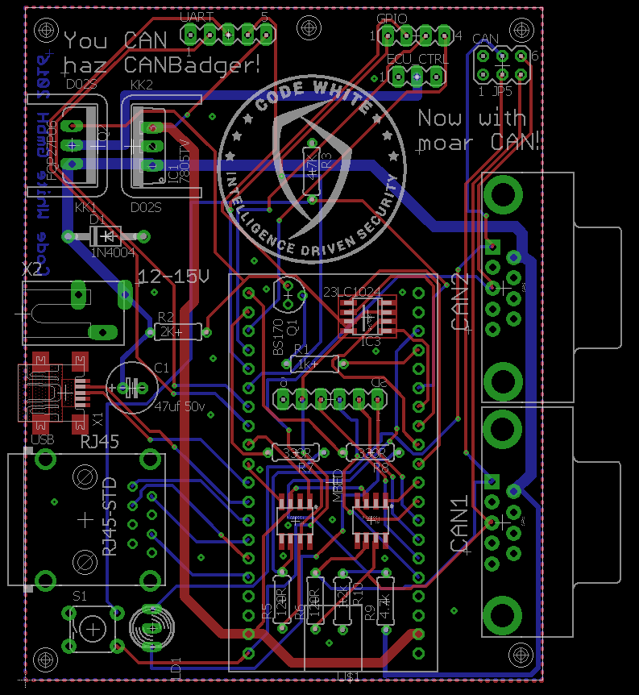
You CAN haz car secretz!
Javier Vazquez Vidal
Ferdinand Noelscher

Slide 2

Overview
1)CAN bus protocols
1.1)UDS
1.2)TP 2.0
1.3)SIDs
1.4)Diagnostics (PIDs)
2)CANBadger Features
3)CANBadger Standalone Mode
4)CANBadger USB mode
5)CANBadger GUI

Slide 3
CAN bus protocols: UDS
What is UDS?
UDS stands for Unified Diagnostics Service
It is present in all modern cars
Provides access to the Services offered by ECUs
It takes place on the top of the CAN protocol (Layer 4)
Allows to perform transmissions of up to 256 bytes
It is just a Transport Protocol

Slide 4
CAN bus protocols: UDS
What types of transmissions exist in UDS?
Single frame transmissions (7 bytes or less payload length)
Multiple frame transmissions (more than 7 bytes payload length)

Slide 5
CAN bus protocols: UDS
What kind of frames exist in UDS?
No ACK request, part of multiframe transmission(0x20)
ACK request, part of multiframe transmission (0x10)
No ACK request, single frame (0x00)
ACK (0x30)
NACK/Repeat transmission

Slide 6
CAN bus protocols: UDS
How is an UDS transmission constructed?
Transmission type is always stored in form of “first byte of the frame” & 0xF0. This means that it is determined by the 4 MSBs.
If it’s a single frame transmission, the first byte indicates transmission type and payload length (& 0x0F). The rest of the frame is the payload.
If it’s a multiframe, the first byte indicates if there is an ACK request (0x10) or not (0x20), plus a counter that goes from 0x00 to 0x0F and that is reset on every transmission. The transmission length is indicated by the second byte in the first frame of the transmission.

Slide 7
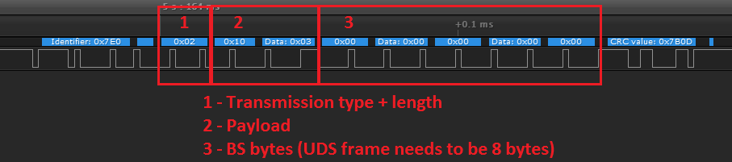
CAN bus protocols: UDS
Single frame transmission example

Slide 8
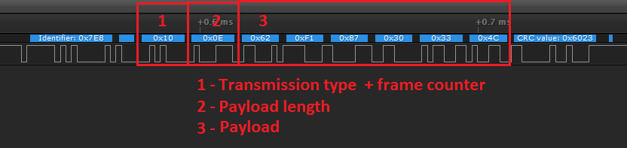
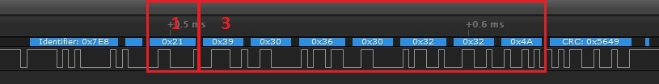
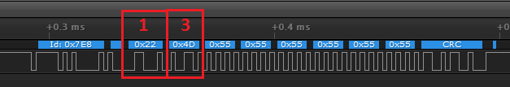
CAN bus protocols: UDS
Multiframe Transmission Example

Slide 9
CAN bus protocols: UDS
Did you notice?
When the BS bytes are 0x00, it means that the payload is native UDS
When the BS bytes are 0x55, it means that the payload is KWP2000 over UDS (notice the Tester Address 0xF1 as well).

Slide 10
CAN bus protocols: TP 2.0
What is TP 2.0?
TP stands for Tunneling protocol
It is present in some ECUs and used for internal communications
It is a port of the K-LINE protocol (KWP2000)
It takes place on the top of the CAN protocol (Layer 4)
Allows to perform transmissions of up to 256 bytes
It is (again) just a Transport Protocol

Slide 11
CAN bus protocols: TP 2.0
What types of transmissions exist in Tp 2.0?
Single frame transmissions (5 bytes or less payload length)
Multiple frame transmissions (more than 5 bytes payload length)

Slide 12
CAN bus protocols: TP 2.0
What kind of frames exist in TP 2.0 transmissions?
No ACK request, with following frames(0x20)
ACK request, with following frames(0x00)
No ACK request, last frame (0x30)
ACK request, last frame (0x10)
ACK (0xB0)
NACK/Repeat transmission (0x90)

Slide 13
CAN bus protocols: TP 2.0
Channel negotiation
Before starting communications, a Channel must be established
Channel request ID is usually 0x200
Module address is used to indicate target (1 byte)
Reply ID from target module is formed by “Channel request ID + Target Module address”
Channel is negotiated for an App
IDs to be used will be provided by the Server (ECU)
The negotiated IDs are not always the same

Slide 14
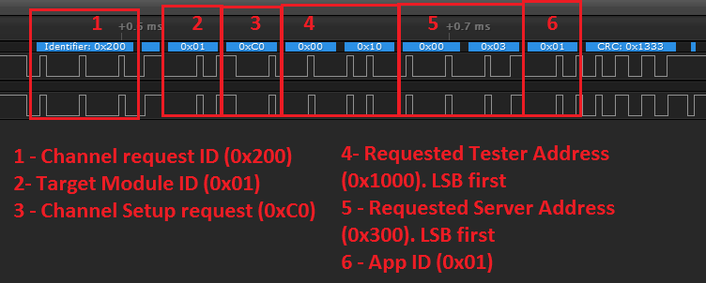
CAN bus protocols: TP 2.0
Channel negotiation: Request

Slide 15
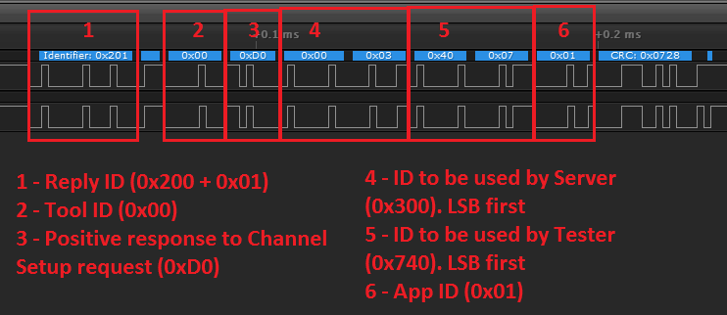
CAN bus protocols: TP 2.0
Channel negotiation: Response

Slide 16
CAN bus protocols: TP 2.0
Channel Parameters
They are negotiated right after the channel is set up
They are requested ever 500ms – 1000ms to keep the channel alive
The related requests are:
Parameters request (0xA0)
Parameters response (0xA1)
Channel test (0xA3)
Channel break (0xA4)
Channel disconnect (0xA8)

Slide 17
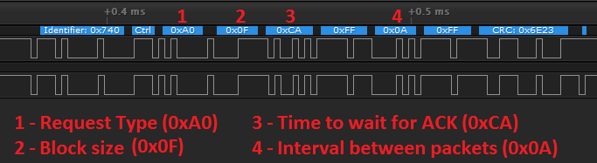
CAN bus protocols: TP 2.0
Channel Parameters message structure
Byte 0 indicates type of request
Byte 1 indicates Block size (Number of packets to send before expecting an ACK)
Byte 2 indicates the time to wait for an ACK in ms
Byte 4 indicates the interval between two packets in ms

Slide 18
CAN bus protocols: TP 2.0
Transmission handling – Frame counters
Each side of the channel has its own counter.
Each counter is incremented by one with every frame sent, except for ACKs and NACKs
ACKs are constructed by adding one to the counter of the other side, plus 0xB0.
Counters go from 0x00 to 0x0F. Once they reach 0xF0, they are reset back to 0x00.

Slide 19
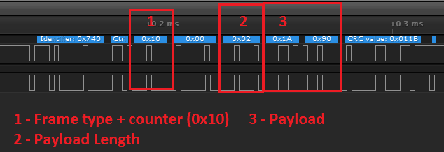
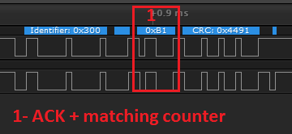
CAN bus protocols: TP 2.0
TP 2.0 transmission example

Slide 20
CAN bus protocols: SIDs
What is an SID?
SID stands for Service ID.
Since the target (ECU) is a Server, it provides Services!
Most SIDs take parameters.
There are standard parameters, and OEM specific ones (usually hidden).
Access to some SIDs require SecurityAccess before requesting them.

Slide 21
CAN bus protocols: SIDs
Fun Facts about SIDs
SID replies are always formed by (request + 0x40)
They are the first byte of the payload
SID 0x7F means “error”, and the reasons are passed as data
SecurityAccess is required to access some SIDS. It is an authentication that is performed by the tester, to prove the Server that it has legit access to its functions.
There are absolutely no checks in any data obtained by the Server, but there are some checks performed by the Server for some data sent by the tool.

Slide 22
CAN bus protocols: SIDs
Most interesting SIDs:
Read Data by ID / Common ID(0x22)
Write Data by ID / Common ID (0x2E)
Diagnostics Session control / Start Diag Session (0x10)
ECU Reset (0x11)
Security Access (0x27)
Read Memory by Address (0x23)
Write Memory by Address (0x3D)
Request Upload (0x35)
Routine Control (0x31) and its KWP2000 variants

Slide 23
CAN bus protocols: SIDs
Read Data by ID / Common ID (0x22)
Great for information gathering
No SecurityAccess required
Provides data such as VIN, HW platform, SW version…
Write Data by ID / Common ID (0x2E)
Allows to modify the Information provided by the Server in the “Read Data by ID” SID.
Some parameters require SecurityAccess, but not always ☺

Slide 24
CAN bus protocols: SIDs
Diagnostics Session Control (0x22 - UDS)
Start Diagnostics Session (0x10 – TP2.0)
Allows to start an specific type of Diagnostics Session
SecurityAccess might be required for some type of Sessions
Each type of Diagnostics Session enables access to certain SIDs
ECU Reset (0x11)
Resets the ECU to a Soft state, Hard state, or Ignition toggle state.
It is specially useful when then ECU becomes blocked or unresponsive.
It will just JMP 0 or wipe RAM, but will not restore default firmware or any data that is modified in FLASH or EEPROM.

Slide 25
CAN bus protocols: SIDs
Security Access (0x27)
Provides access to restricted SIDs if challenge is passed.
It’s based on a challenge-response.
Bruteforcing is not an option, since the seed is random on every challenge.
Key length is 4 bytes.
Algorithm used changes from one ECU to another, an even from same one on different FW versions.
Read Memory by Address(0x23)
Allows to read memory (Flash, RAM, EEPROM).
Most of the times, requires SecurityAccess. But not always ;)
Some ranges are restricted, and will not be readable even if SecurityAccess is provided.

Slide 26

Because randomness

Slide 27
CAN bus protocols: SIDs
Write Memory by Address(0x3D)
Allows to write memory (Flash, RAM, EEPROM).
Most of the times, requires SecurityAccess. But not always ;)
Some ranges are restricted, and will not be writeable even if SecurityAccess is provided.
Request Upload(0x35)
Pretty much like Read Mem by Address, but with additional options.
Allows to read memory using encryption and/or compression for transfer

Slide 28
CAN bus protocols: SIDs
Routine Control(0x31)
Allows to start, stop, and check results for routines
A routine is either an standard (Erase Flash) or vendor specific (retrieve boot keys, unlock debug port, skip signature checking…) process that is run by the ECU.
They usually require SecurityAccess, but again, not always.

Slide 29
CANBadger – First things first!
First things you should do:
Format the SD on your computer (!) to FAT32
Insert the SD
Rename your CanBadger, if using Ethernet mode
Verify that folders are correctly set up after first boot
Unless you are using power from OBD/DB9 Connectors, make sure you have the12V plugged

Slide 30
CANBadger Features: Standalone mode
Standalone mode does not require a PC.
MITM mode
CAN Logger (Standard Mode)
CAN Logger (Bridge Mode)
Delete CAN log
Emulation mode
Replay mode
Emulation data generation

Slide 31
CANBadger Features: USB mode
USB mode emulates a CDC device (USB to Serial).
TP 2.0 Diag Session
Diagnostic Session Control
Switch to XX Session
Switch to Custom Session
Scan for available Session types
Read Data by ID
All data
Specific data
Custom ID
Scan for available IDs

Slide 32
CANBadger Features: USB mode
TP 2.0 Diag Session
Security Access
Use known algorithm
Level 1
Level 3
Manual Authentication (currently not implemented)
ECU Reset
Hard
Ignition
Soft
Custom

Slide 33
CANBadger Features: USB mode
TP 2.0 Diag Session
Memory operations
Request Upload
Terminate Current Session
UDS Diag Session
Everything is the same, except:
Memory operations
Read Memory by Address

Slide 34
CANBadger Features: USB mode
Scan for TP 2.0 IDs (11-bit)
Scan for UDS IDs (11-bit)
Change CAN Speed
Detect CAN Speed
Protocol Analysis
Scan current traffic for know protocols
Logging
Log all CAN traffic on CAN1 to SD
Log UDS channel traffic on CAN1 to SD
Log TP 2.0 channel traffic on CAN1 to SD
Log all CAN traffic (Bridge mode) to SD
Log UDS channel traffic (Bridge mode) to SD
Log TP 2.0 channel traffic (Bridge mode) to SD
Manage logs

Slide 35
CANBadger Features: USB mode
Protocol Analysis
Scan current traffic for know protocols
Logging
Manage logs
View log
Generate TP 2.0 log from CAN log
Generate UDS log from CAN log
Scan CAN log for protocols
Delete log
MITM mode
ECU Power
Toggle ECU CTRL power ON/OFF and check input voltage (PSU)

Slide 36
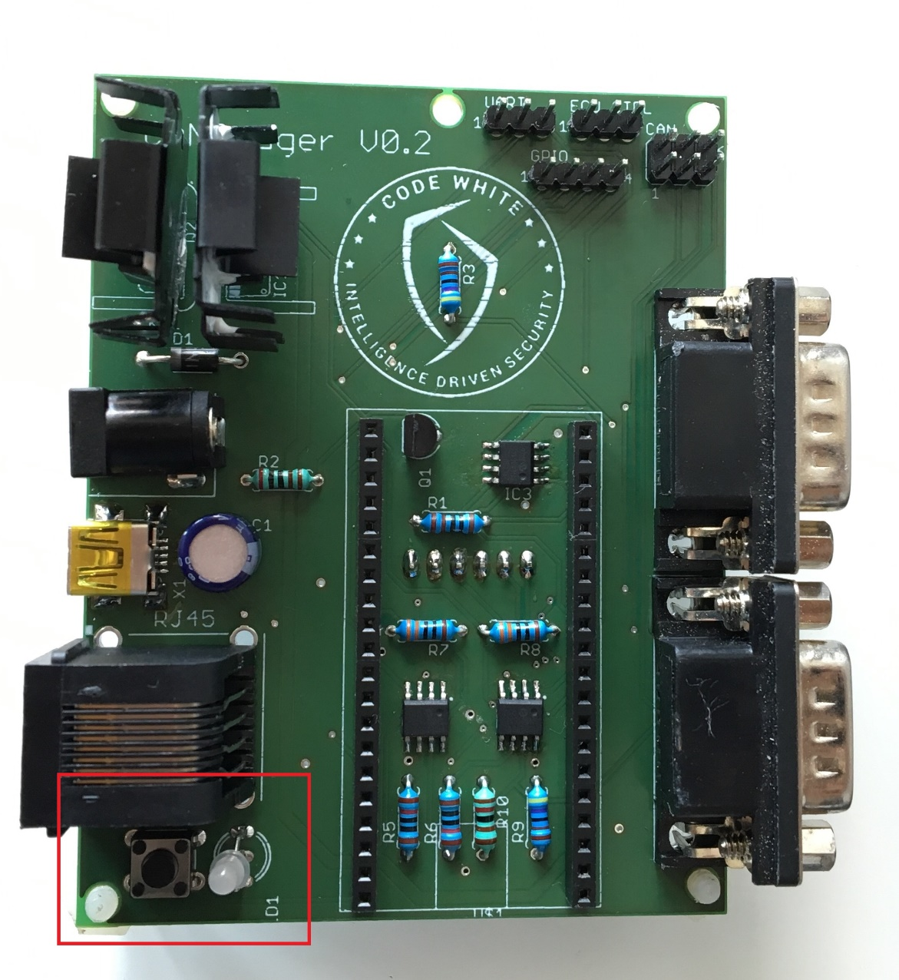
CANBadger Standalone Mode
Operated by the push button.
Status indicated by LED.
Requires SD.
No PC required

Slide 37
CANBadger Standalone Mode
How to use it?
Press the button, the LED will blink in red 3 times.
Press the button the required number of times for the desired action
The LED will blink each time you press the button
Once you have selected the module, the LED will blink in green to indicate the selected one.
After all these blinky show, the LED will remain orange, which means the CANBadger is working on the requested mode.
If instead of orange, it blinks in red, it means that it was not possible to start the requested module.

Slide 38
CANBadger Standalone Mode
Available modules (per number of button presses)
1)MITM mode – Will load rules from SD
2)CAN Logger (Bridge Mode) – Will dump all traffic to SD and bridge comms between CAN1 and CAN2
3)CAN Logger (Standard Mode)- Classic CAN logger, dumps all traffic on CAN1 to SD.
4)Delete CAN Log – Removes the CAN log from SD
5)Emulator mode – Loads emulation data from SD and begins to emulate.
6)Replay CAN – Loads specific standalone replay data from SD, and you can guess the rest (on CAN1)
7)Generate UDS emulator Data – Self descriptive, on CAN1

Slide 39
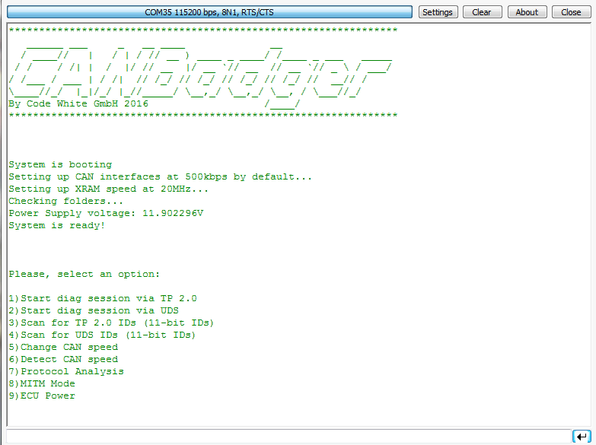
CANBadger USB Mode
Operated via USB
Emulates a CDC device (USB-Serial)
Requires SD.
Extended functionality
Everything is done by the CANBadger firmware, only a Serial terminal is required.

Slide 40
CANBadger Ethernet Mode
Purpose:
Make using the CanBadger even easier
Use multiple CanBadgers in parallel
Provide programmable access to automate stuff

Slide 41
CANBadger Ethernet Mode - GUI
Feature | Available in UART? | Available in GUI?
CAN Logger | ☺ | ☺
TP | ☺ | ☹
UDS | ☺ | ☹
Security Hijack | ☺ | ☹
MITM | ☺ | ☺
Create MITM Rules | ☹ | ☺
Emulator | ☺ | ☹
Read SD Files | ☹ | ☺
Modify CB Settings | ☹ | ☺

Slide 42
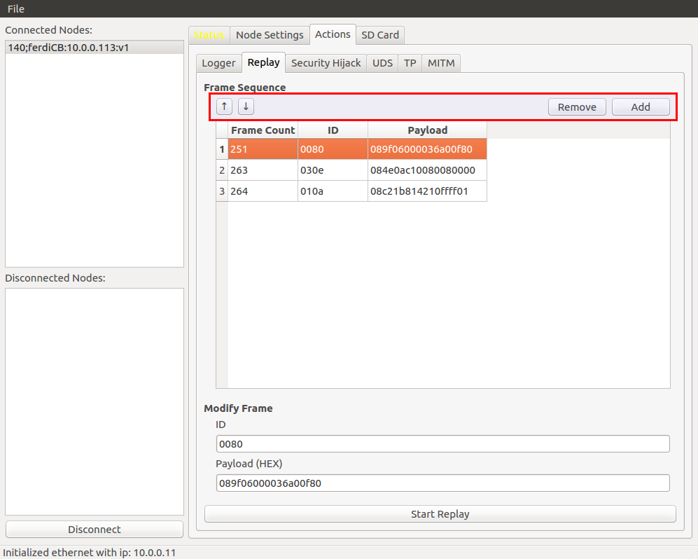
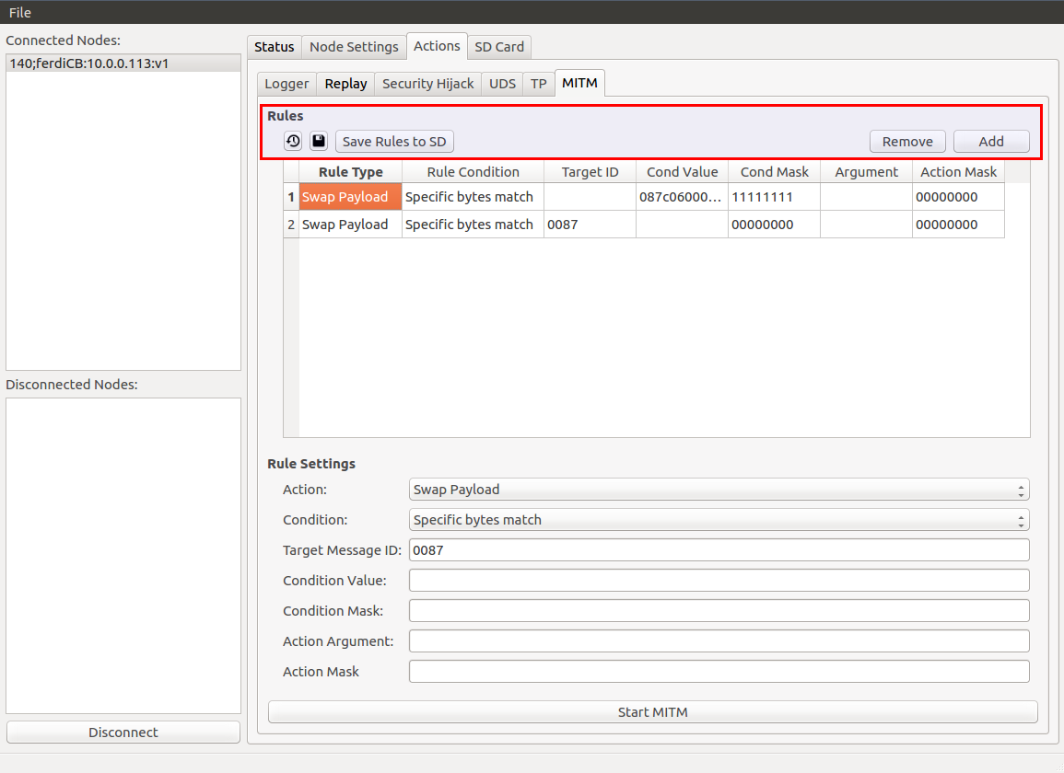
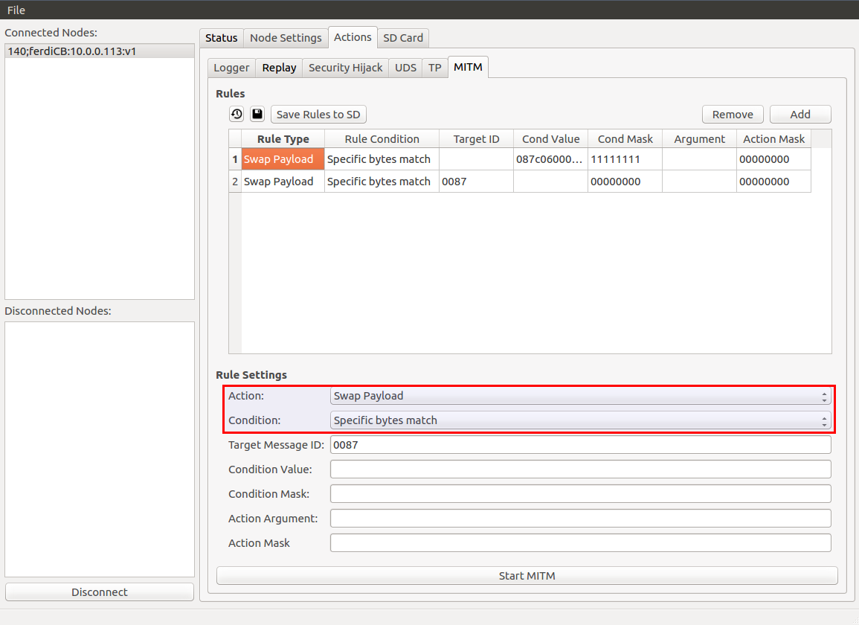
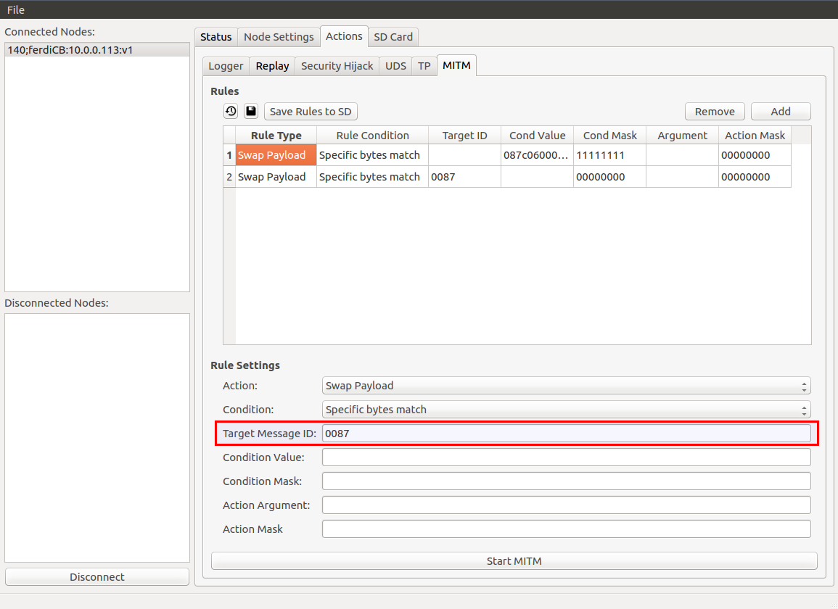
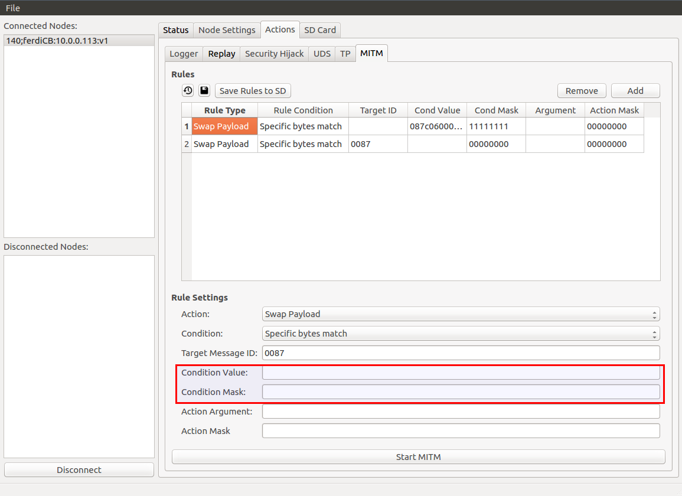
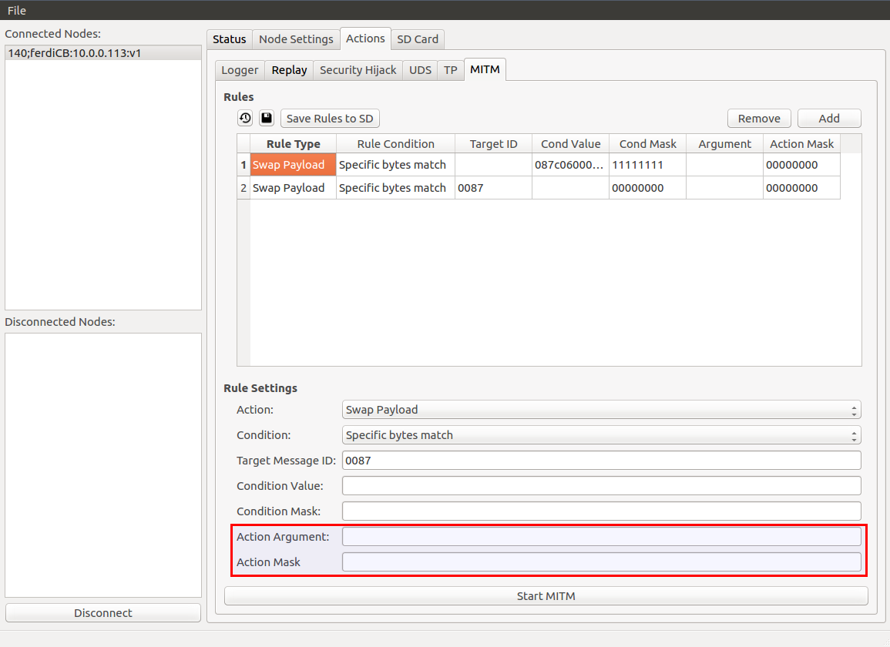
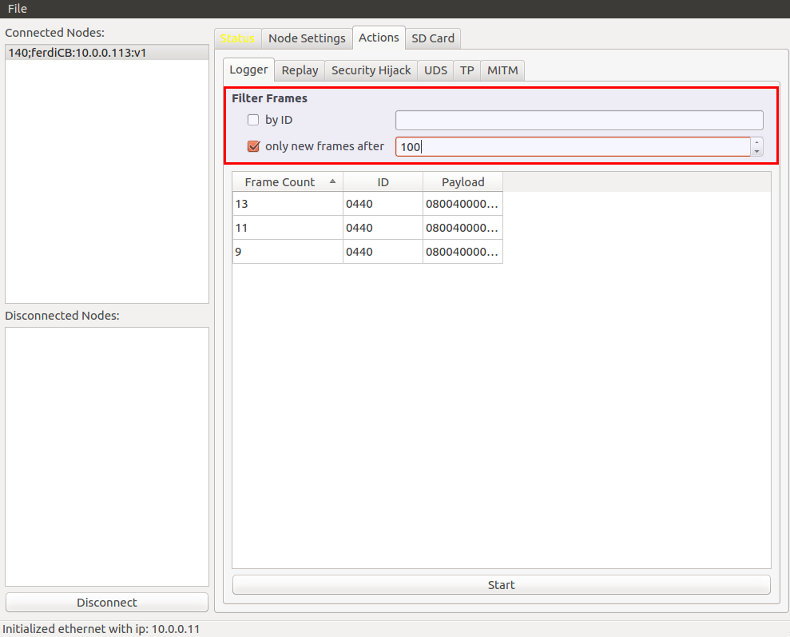
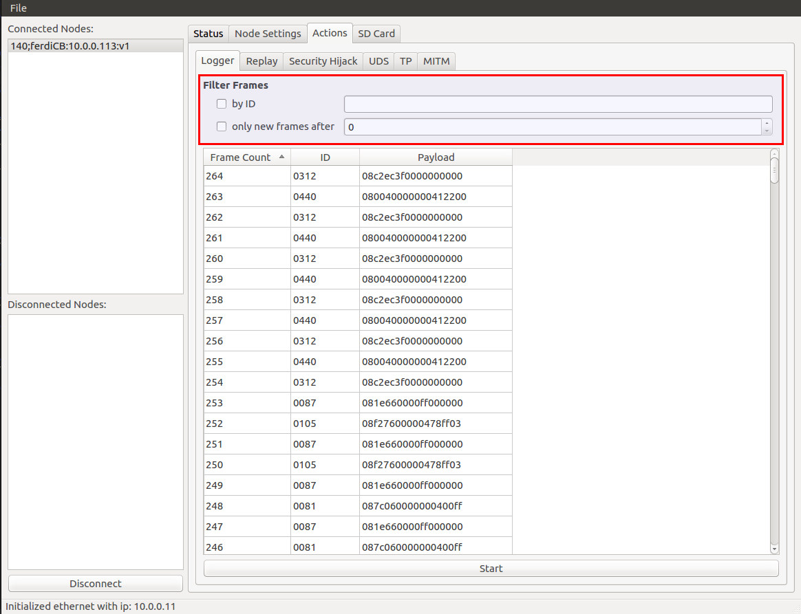
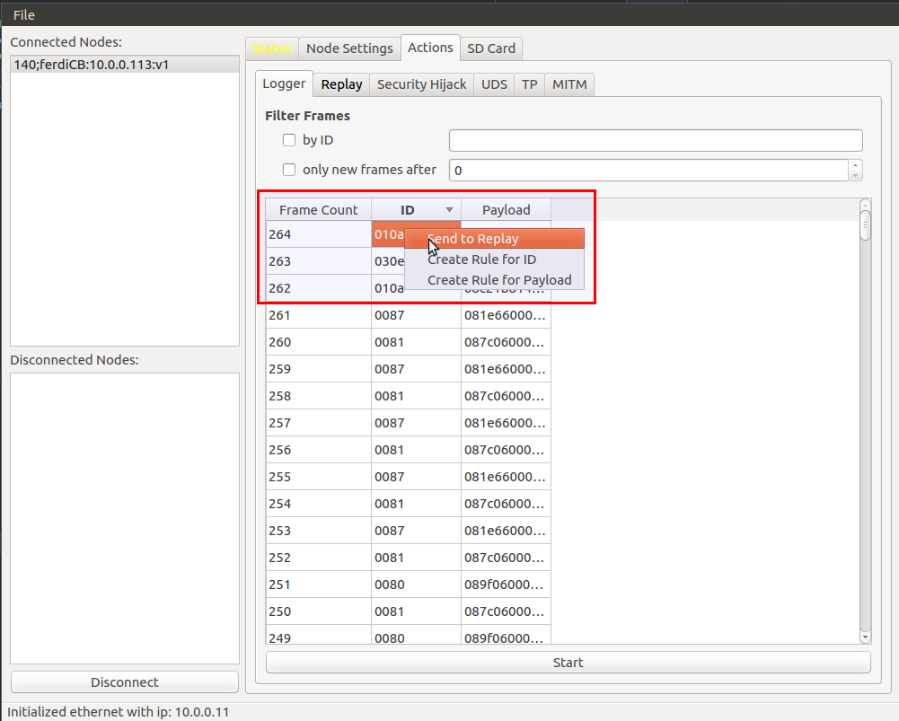
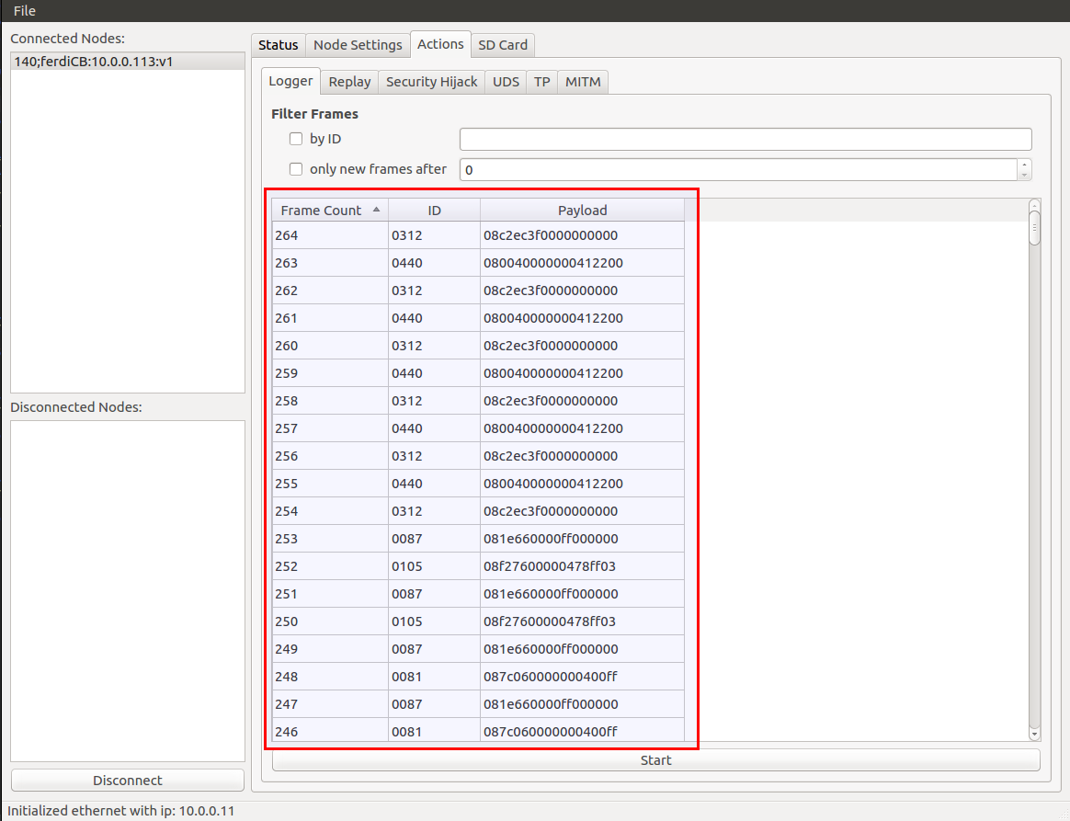
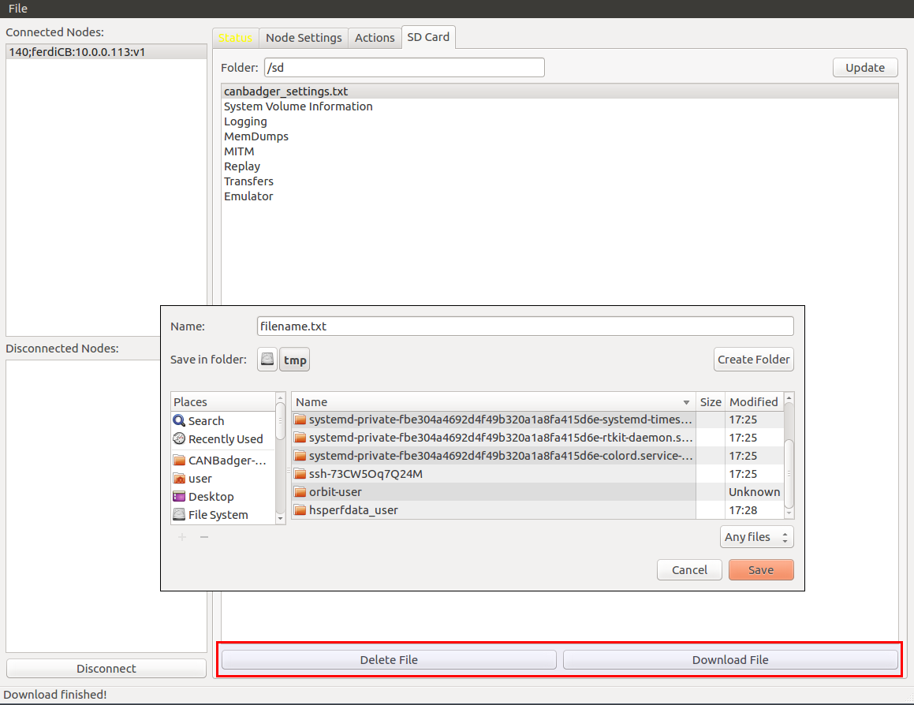
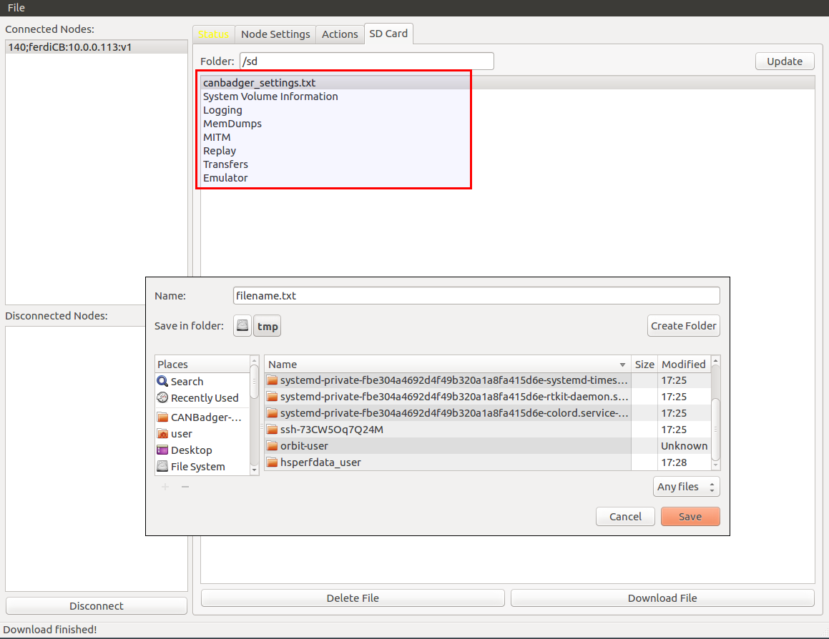
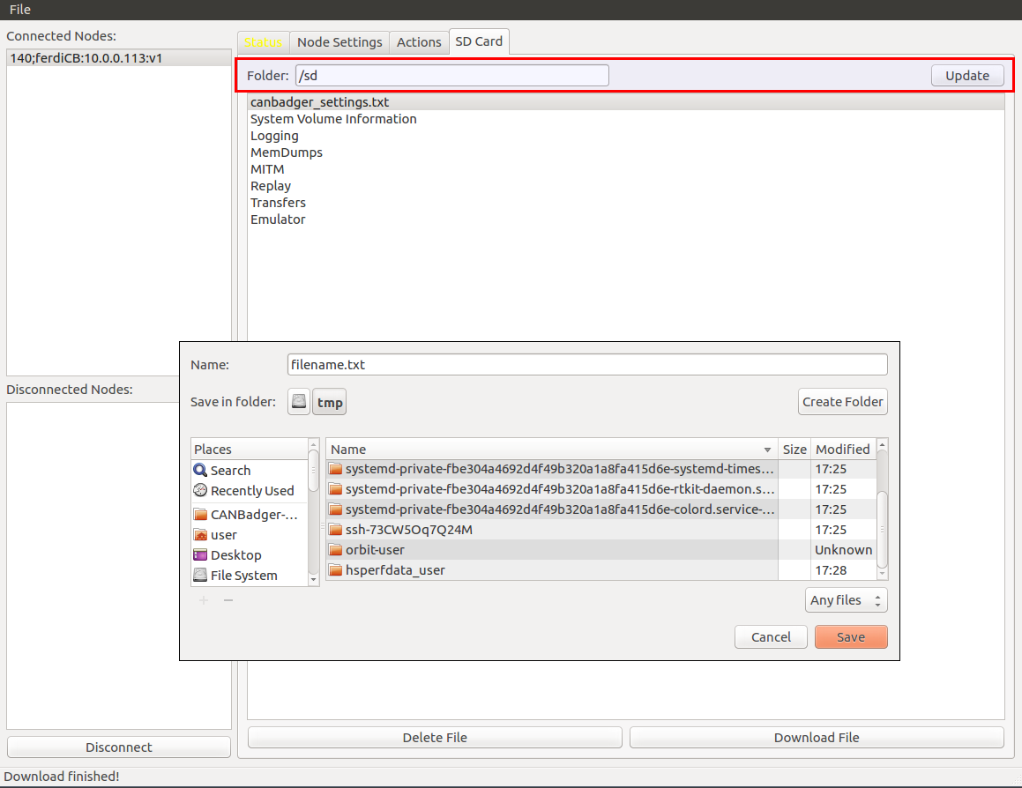
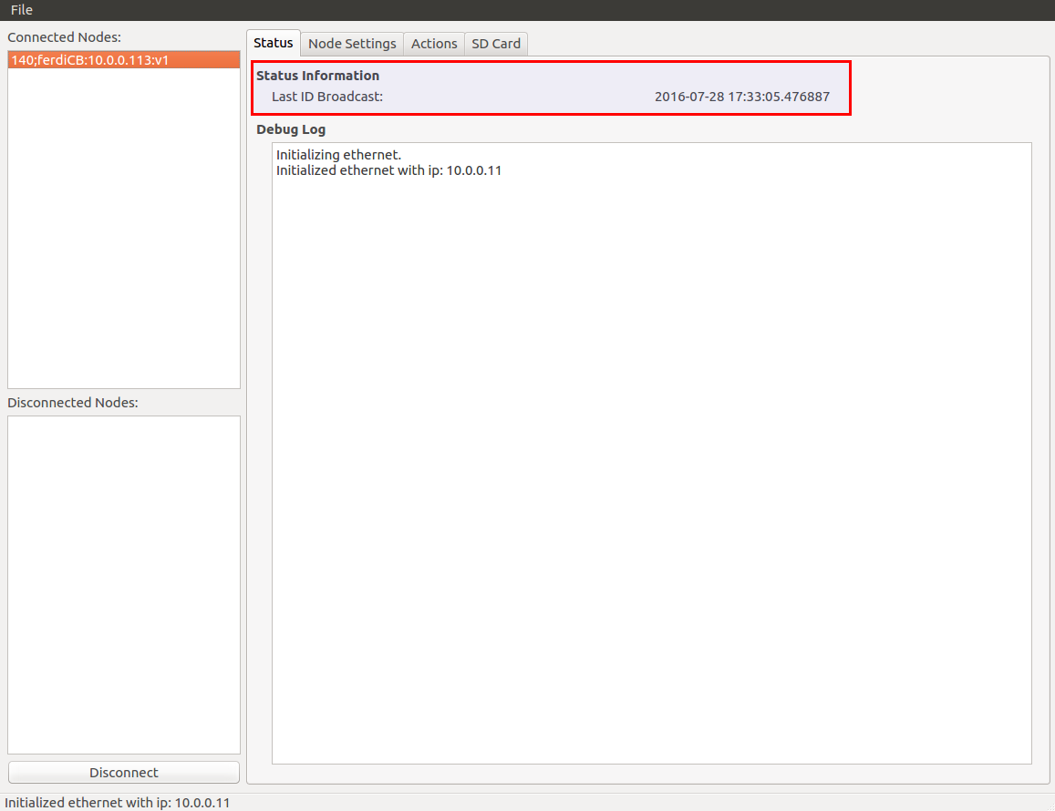
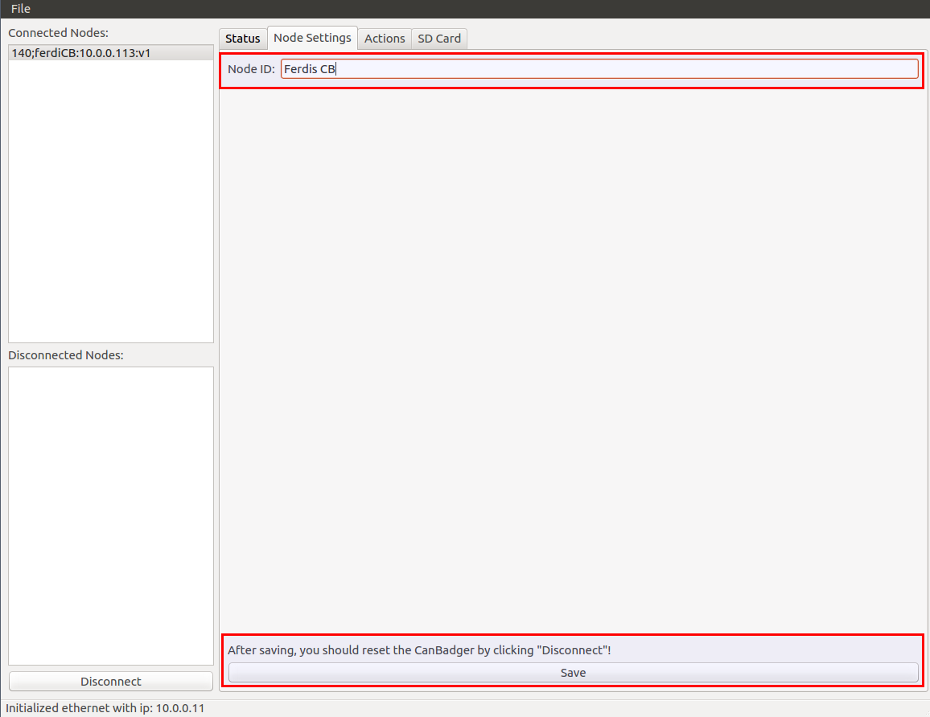
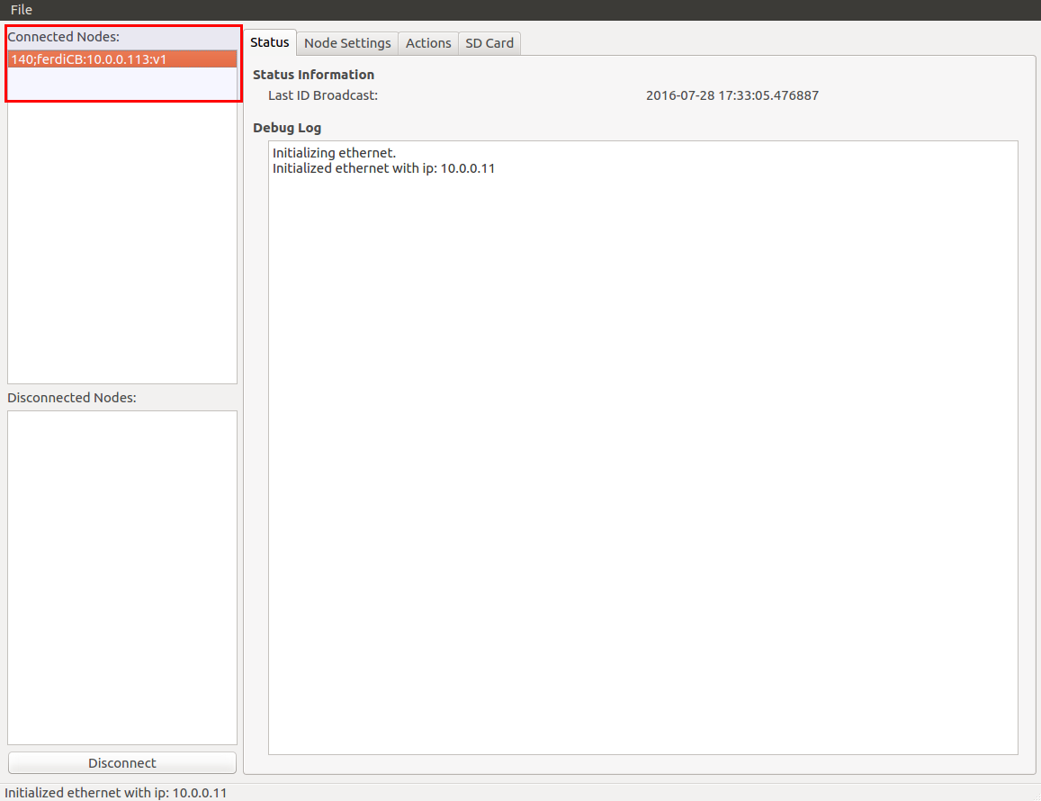
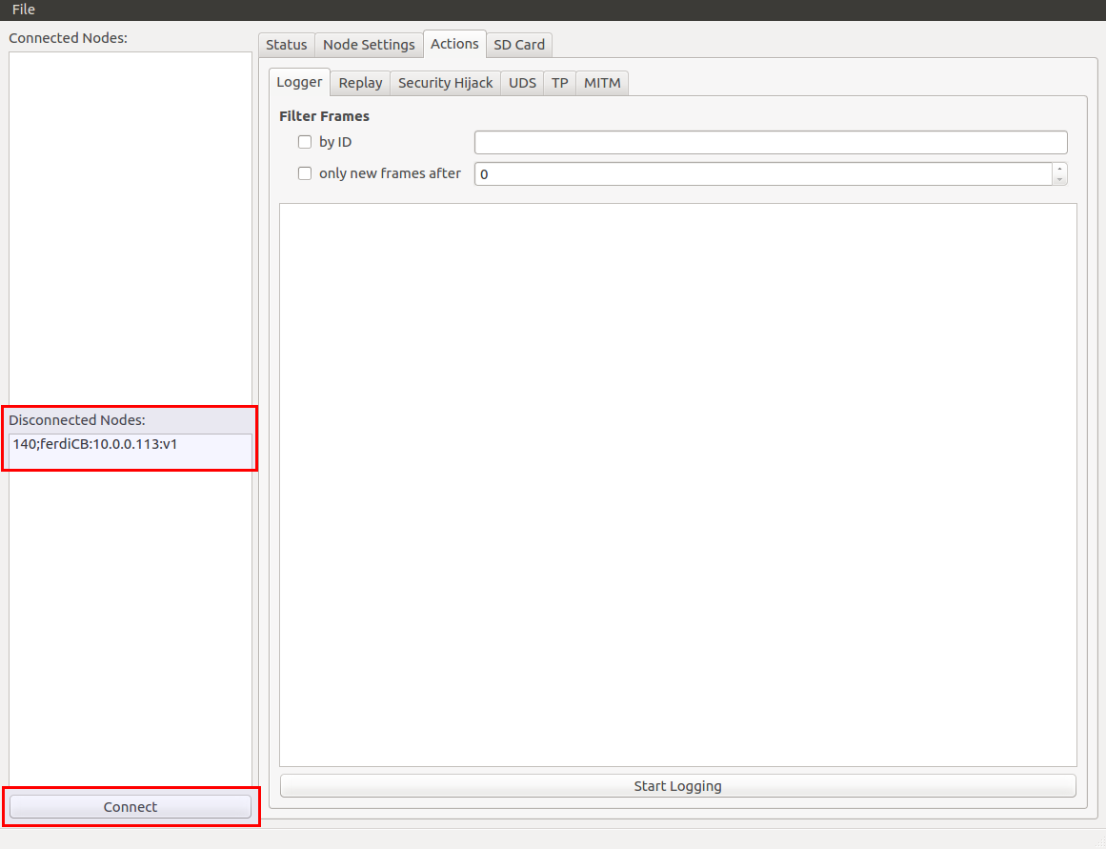
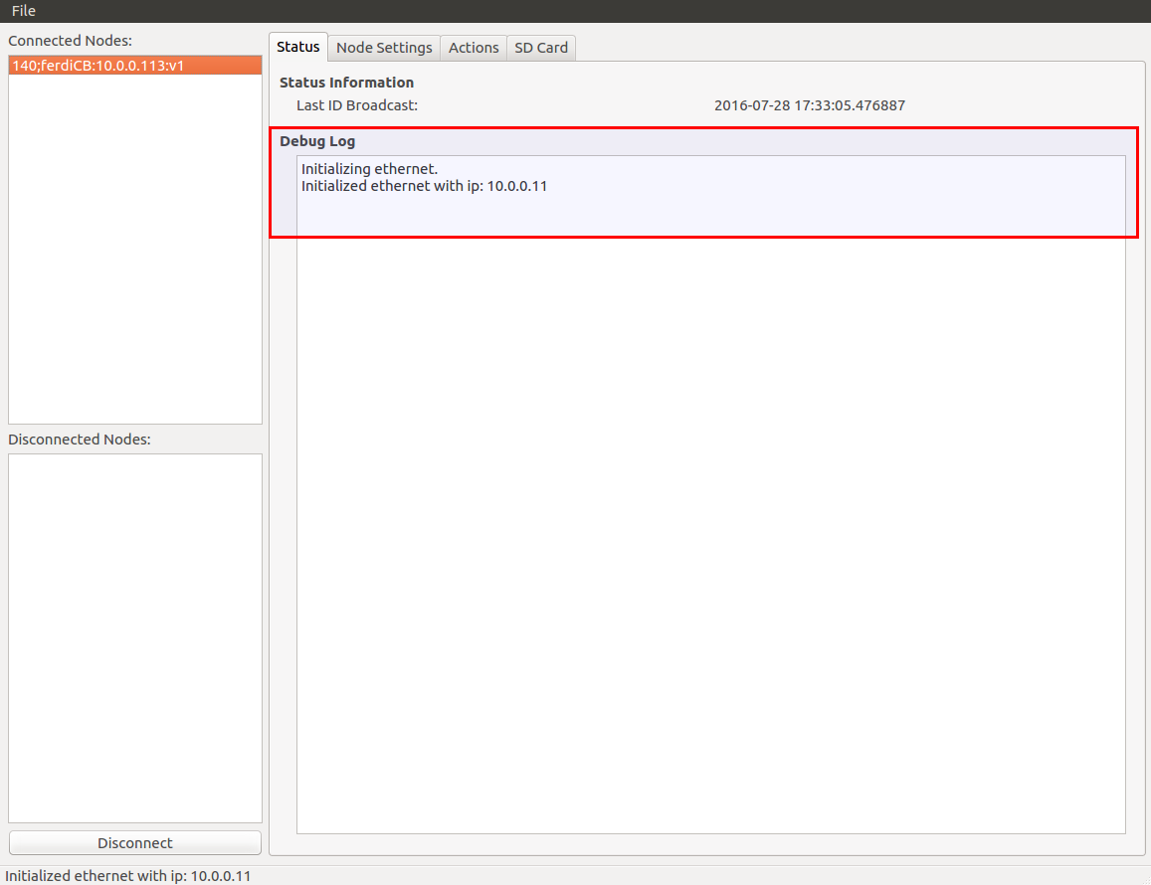
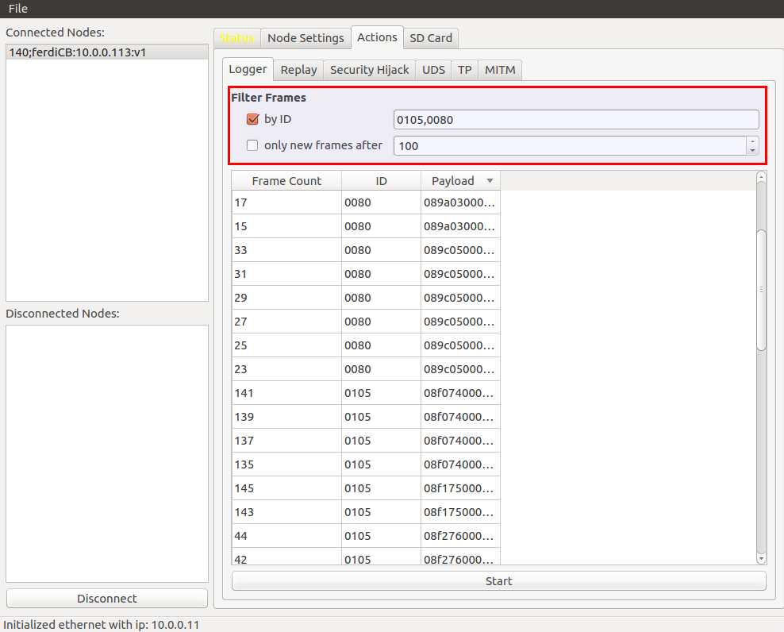
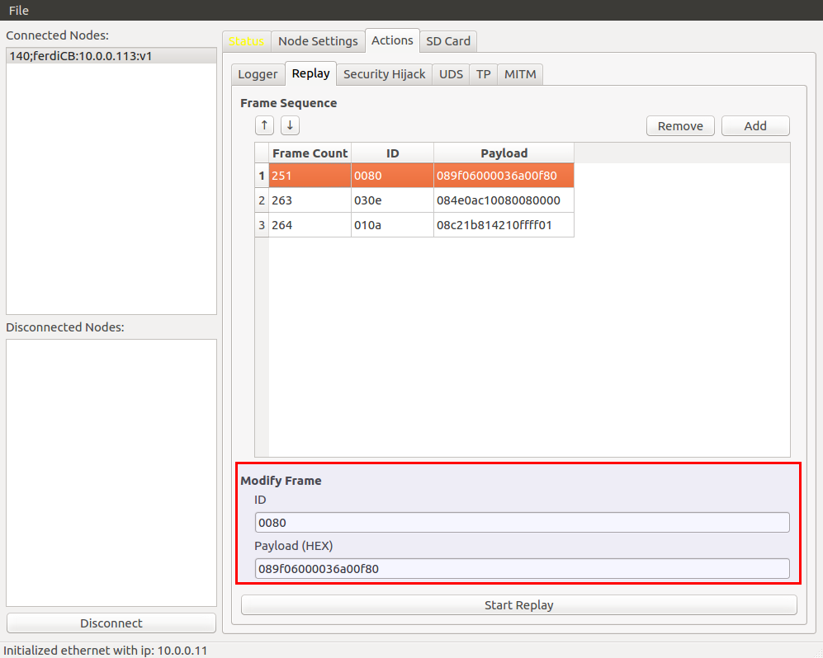
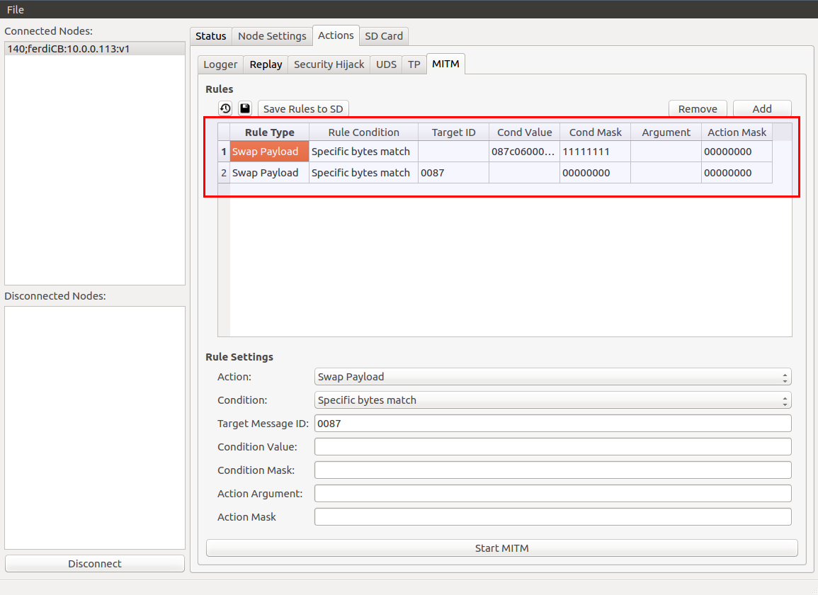
CANBadger Ethernet Mode - GUI

Slide 43
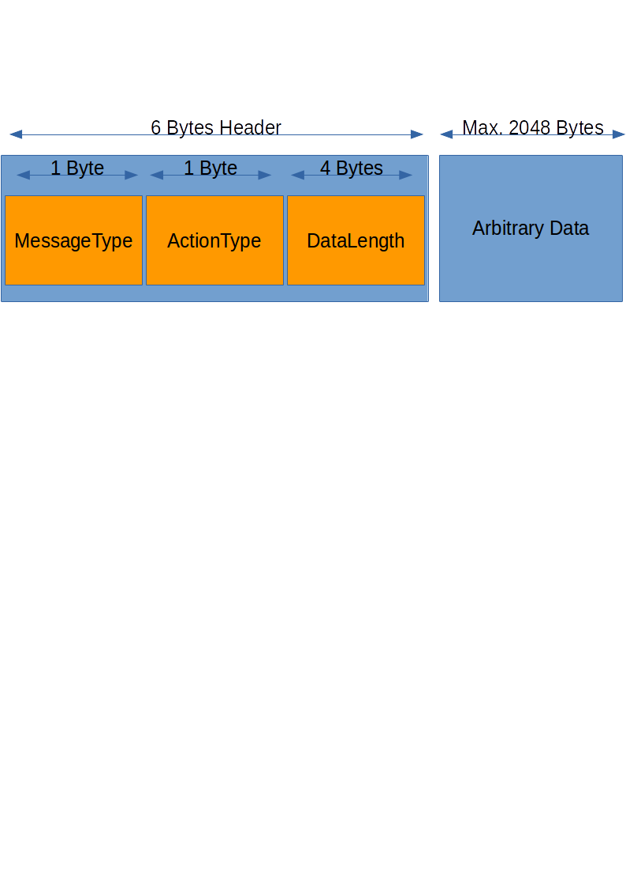
CANBadger Ethernet Mode - Protocol

Slide 44
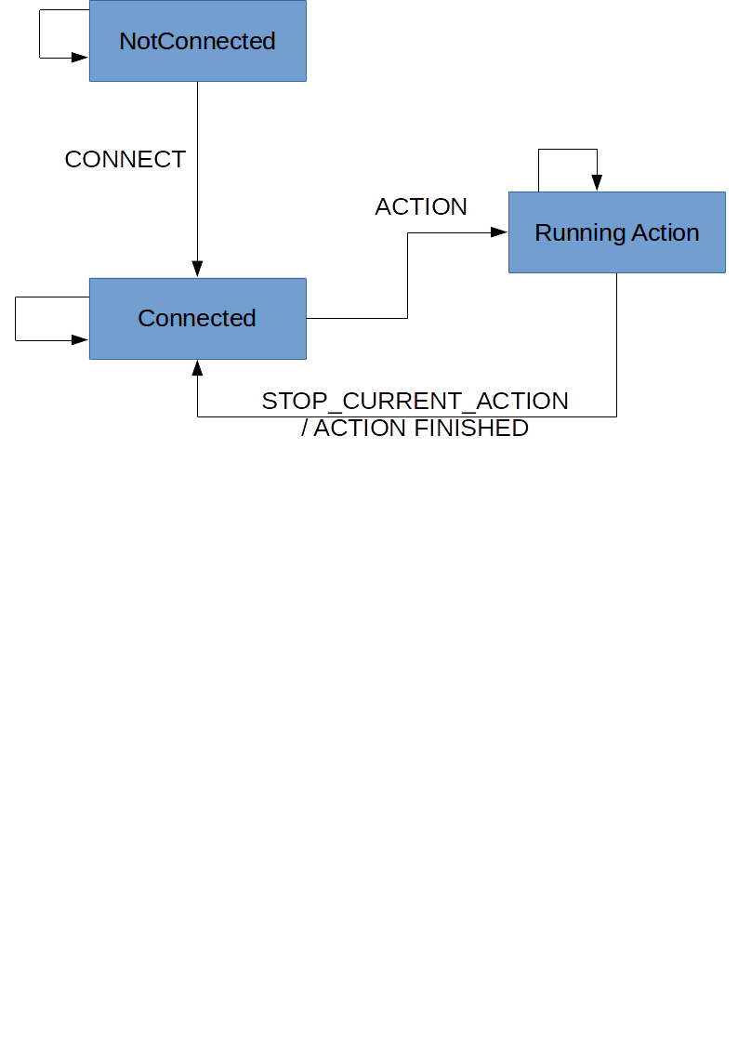
CANBadger Ethernet Mode - Protocol
States:

Slide 45
CANBadger Ethernet Mode – Rule File Format
B01,380,12,FF,00,F3,00,00,00,00,00,11,22,33,44,55,66,77,88
/sd/MITM/rules.txt
ASCII-Hex encoded bytes or double-bytes
Separated by commas

Slide 46
CANBadger Ethernet Mode – Rule File Format
B01,380,12,FF,00,F3,00,00,00,00,00,11,22,33,44,55,66,77,88
First byte: Condition mask 10110000 = 0xB0
Second byte: Condition type = 1
Condition Type | Entire PL Matches | Specific PL Bytes match | Specific PL bytes are greater | Specific PL bytes are less
Value | 0x00 | 0x01 | 0x02 | 0x03

Slide 47
CANBadger Ethernet Mode – Rule File Format
B01,380,12,FF,00,F3,00,00,00,00,00,11,22,33,44,55,66,77,88
Target msg ID is mandatory
Rules are stored in the XRAM in a key-value matter
The ID is the lookup key

Slide 48
CANBadger Ethernet Mode – Rule File Format
B01,380,12,FF,00,F3,00,00,00,00,00,11,22,33,44,55,66,77,88
Condition Payload Data
Mandatory, as condition should match payload too
Can be all 0, for example when mask is 0

Slide 49
CANBadger Ethernet Mode – Rule File Format
B01,380,12,FF,00,F3,00,00,00,00,00,11,22,33,44,55,66,77,88
First Byte: Action mask
Second Byte: Action type
Action Type | Swap PL | Swap specific bytes | Add fixed Value to specific bytes | Substract fixed value to specific bytes | Multiply specific bytes | Divide specific bytes | Increase specific bytes by % | Decrease by % | Drop
Value | 0x00 | 0x01 | 0x02 | 0x03 | 0x04 | 0x05 | 0x06 | 0x07 | 0x08

Slide 50
CANBadger Ethernet Mode – Rule File Format
B01,380,12,FF,00,F3,00,00,00,00,00,11,22,33,44,55,66,77,88
Action Payload
Examples:
The payload to swap
A percentage
(in that case the following bytes are 0)

Slide 51
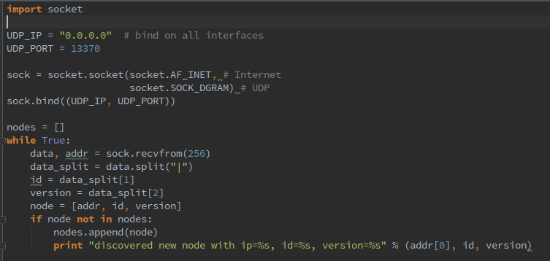
CANBadger Ethernet Mode - Code
List available Nodes:

Slide 52
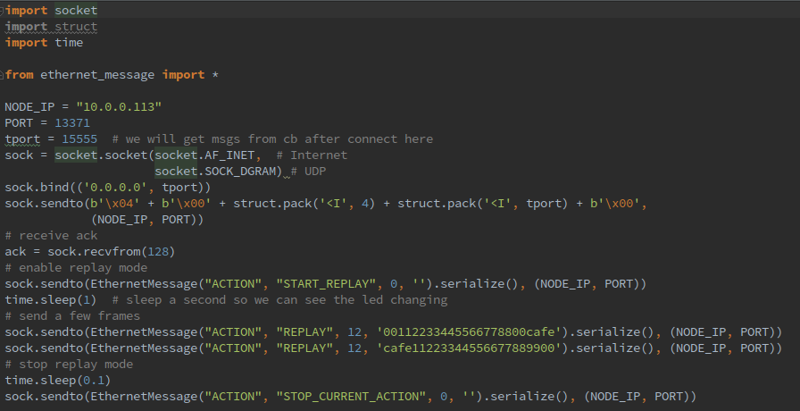
CANBadger Ethernet Mode - Code
Replay a frame:

Slide 53
Hacking Instructions
Main IDE we used for firmware is LPCXpresso
Has code limit in free version
For quick modifications you can also use the mbed online compiler
Export to Keil/IAR/CooCox is possible

Slide 54
Hacking Instructions
Code will be published on Github shortly after DC
You are encouraged to add Issues for:
Feature Requests
Bugs
Enhancements

Slide 55

Development aftermath
Trying to find the cause of memory corruptions:

Slide 56

Development aftermath
Merging code after a long time of implementing new features:

Slide 57
Development aftermath
~13000 LoCs Firmware, excluding libraries
~2200 LoCs GUI Code, excluding libraries and config files
190 commits during the last 100 days for firmware
95 commits during the last 100 days for GUI
Most commits were made on Saturdays and Sundays

Slide 58

Development aftermath
Firmware has size of 330k, unoptimized
Flashing that takes long (~30 seconds)
No automated tests lol
Firmware needs refactoring now

Slide 59

Thanks!
To all of you for being here today!
To Code White for their support and trust in the project
To our family and friends for supporting us even when we run out of coffee
Javier Vazquez
@fjvva
Javier.Vazquez.vidal@code-white.com
Ferdinand Nölscher
@s1ckcc
Ferdinand.noelscher@code-white.com

